Slide 1
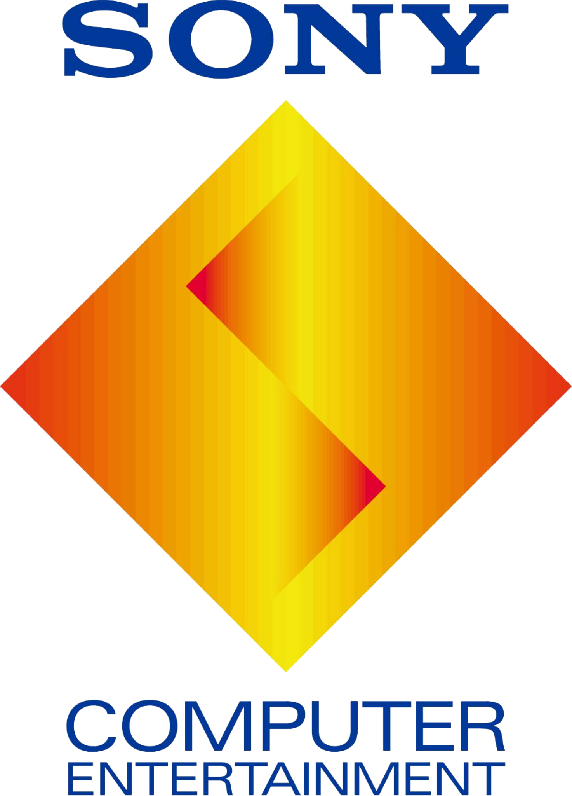
Sony and their stocks
How did their acquisition of companies affect their stock value?

Slide 2

Hypothesis and my guess
Have the companies Sony has acquired affected their stock value? I believe the price does affect the stock value.

Slide 3
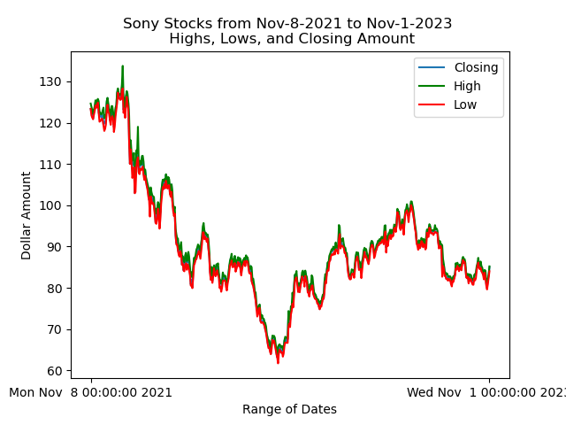
Not so good on the stocks
Sony’s stocks have been on downward trend since late 2021. These stocks represent Sony as a whole and not just their acquired businesses.

Slide 4
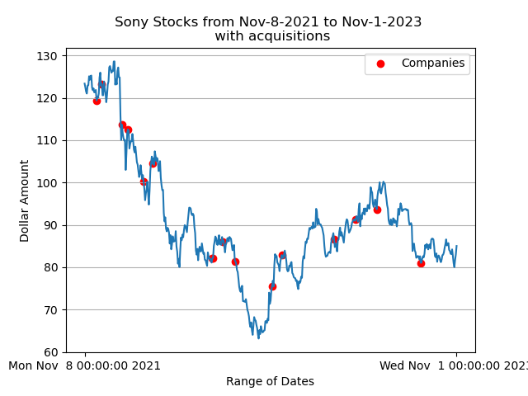
Not slowing down
Despite their stocks being on a downward trend, it seems this has not hampered their acquisition of companies.

Slide 5
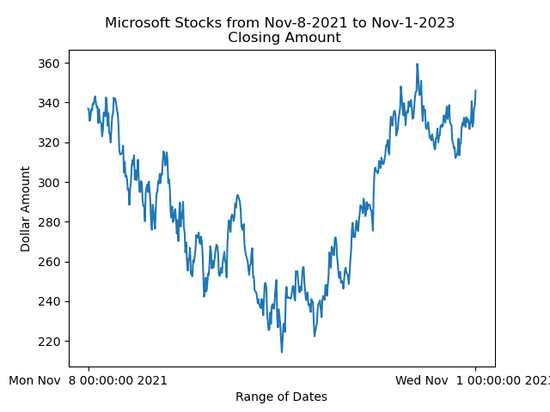
What about the competition?
While Microsoft took a dip in the beginning of 2022, their stock is on the rise.

Slide 6
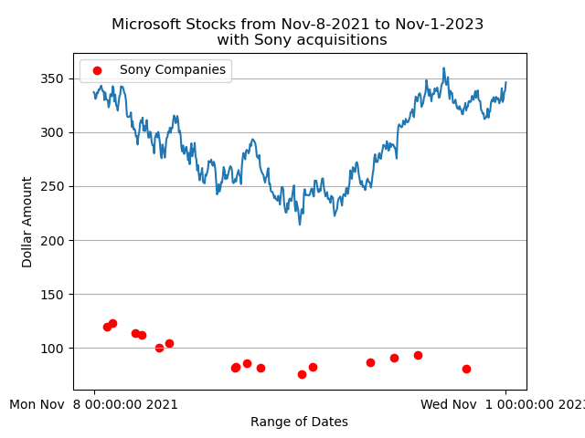
Not very effective…
So far, Sony’s acquisitions of certain companies has not affected Microsoft’s stock values.
Just like before, these values for Microsoft represent themselves overall.

Slide 7
In Conclusion
Despite Sony still acquiring companies, their stocks haven’t seem to go up.
The acquisitions held little to no effect on Sony’s stocks.
They certainly had no effect on Microsoft’s stocks
It’s possible Microsoft’s stocks might affect Sony’s stocks.

Slide 8
Round 2?
Does any of the acquired companies affect any other well known companies, Nintendo, GE, LG.
Do any of the other companies have an effect on Sony?

Slide 9
Sources
Polygon.io for the stock data
"Sony Buys Majority Stake in 'His Dark Materials' Producer Bad Wolf".
"Sony Interactive Entertainment to Acquire Valkyrie Entertainment" (Press release). 10 December 2021. Retrieved 10 December 2021.
"Sony buys full ownership of Ultra Records; Patrick Moxey exits, David Waxman takes over as President". 20 January 2022. Retrieved 20 January 2022.
"Aniplex officially acquires Lasengle from Delightworks". 1 February 2022. Retrieved 1 February 2022.
Andreeva, Nellie (3 March 2022). "Sony Pictures Television Acquires Industrial Media In $300M+ Deal, Restructures Its Unscripted Operations". Deadline. Retrieved 5 March 2022.
"Sony Acquires Haven Studios, the New Developer Led By Jade Raymond".
"Bungie Joins Sony Interactive Entertainment". Bungie.net. Retrieved 31 January 2022.
"Announcement Regarding Completion of the Acquisition of Bungie, Inc. by Sony Interactive Entertainment" (PDF).
"PlayStation continues esports expansion with Repeat.gg acquisition".
"Crunchyroll Purchases Anime Retailer Right Stuf".
"Sony Acquires Mobile Game Developer Savage Game Studios". DualShockers.com. 29 August 2022. Retrieved 29 August 2022.
Tangcay, Jazz (25 October 2022). "Sony Pictures Entertainment Acquires VFX Company Pixomondo". Variety. Retrieved 25 October 2022.
"Welcoming Beyond Sports Into Sony's Sports Businesses". sony.net. 7 November 2022. Retrieved 7 November 2022.
"The Orchard acquires dance and electronic music distribution company Above Board". musicbusinessworldwide.com. 9 March 2023. Retrieved 9 March 2023.
"PlayStation to acquire AAA multiplayer developer Firewalk Studios". 20 April 2023. Retrieved 20 April 2023.
"'Alice In Borderland' Director Shinsuke Sato Teams With Sony's Aniplex Inc To Launch Myriagon Studio". 31 May 2023. Retrieved 31 May 2023.
"Sony is buying gaming headphone maker, Audeze". 24 August 2023. Retrieved 24 August 2023.

